Slide 1
Leap Motion
By Savannah Bolger

Slide 2
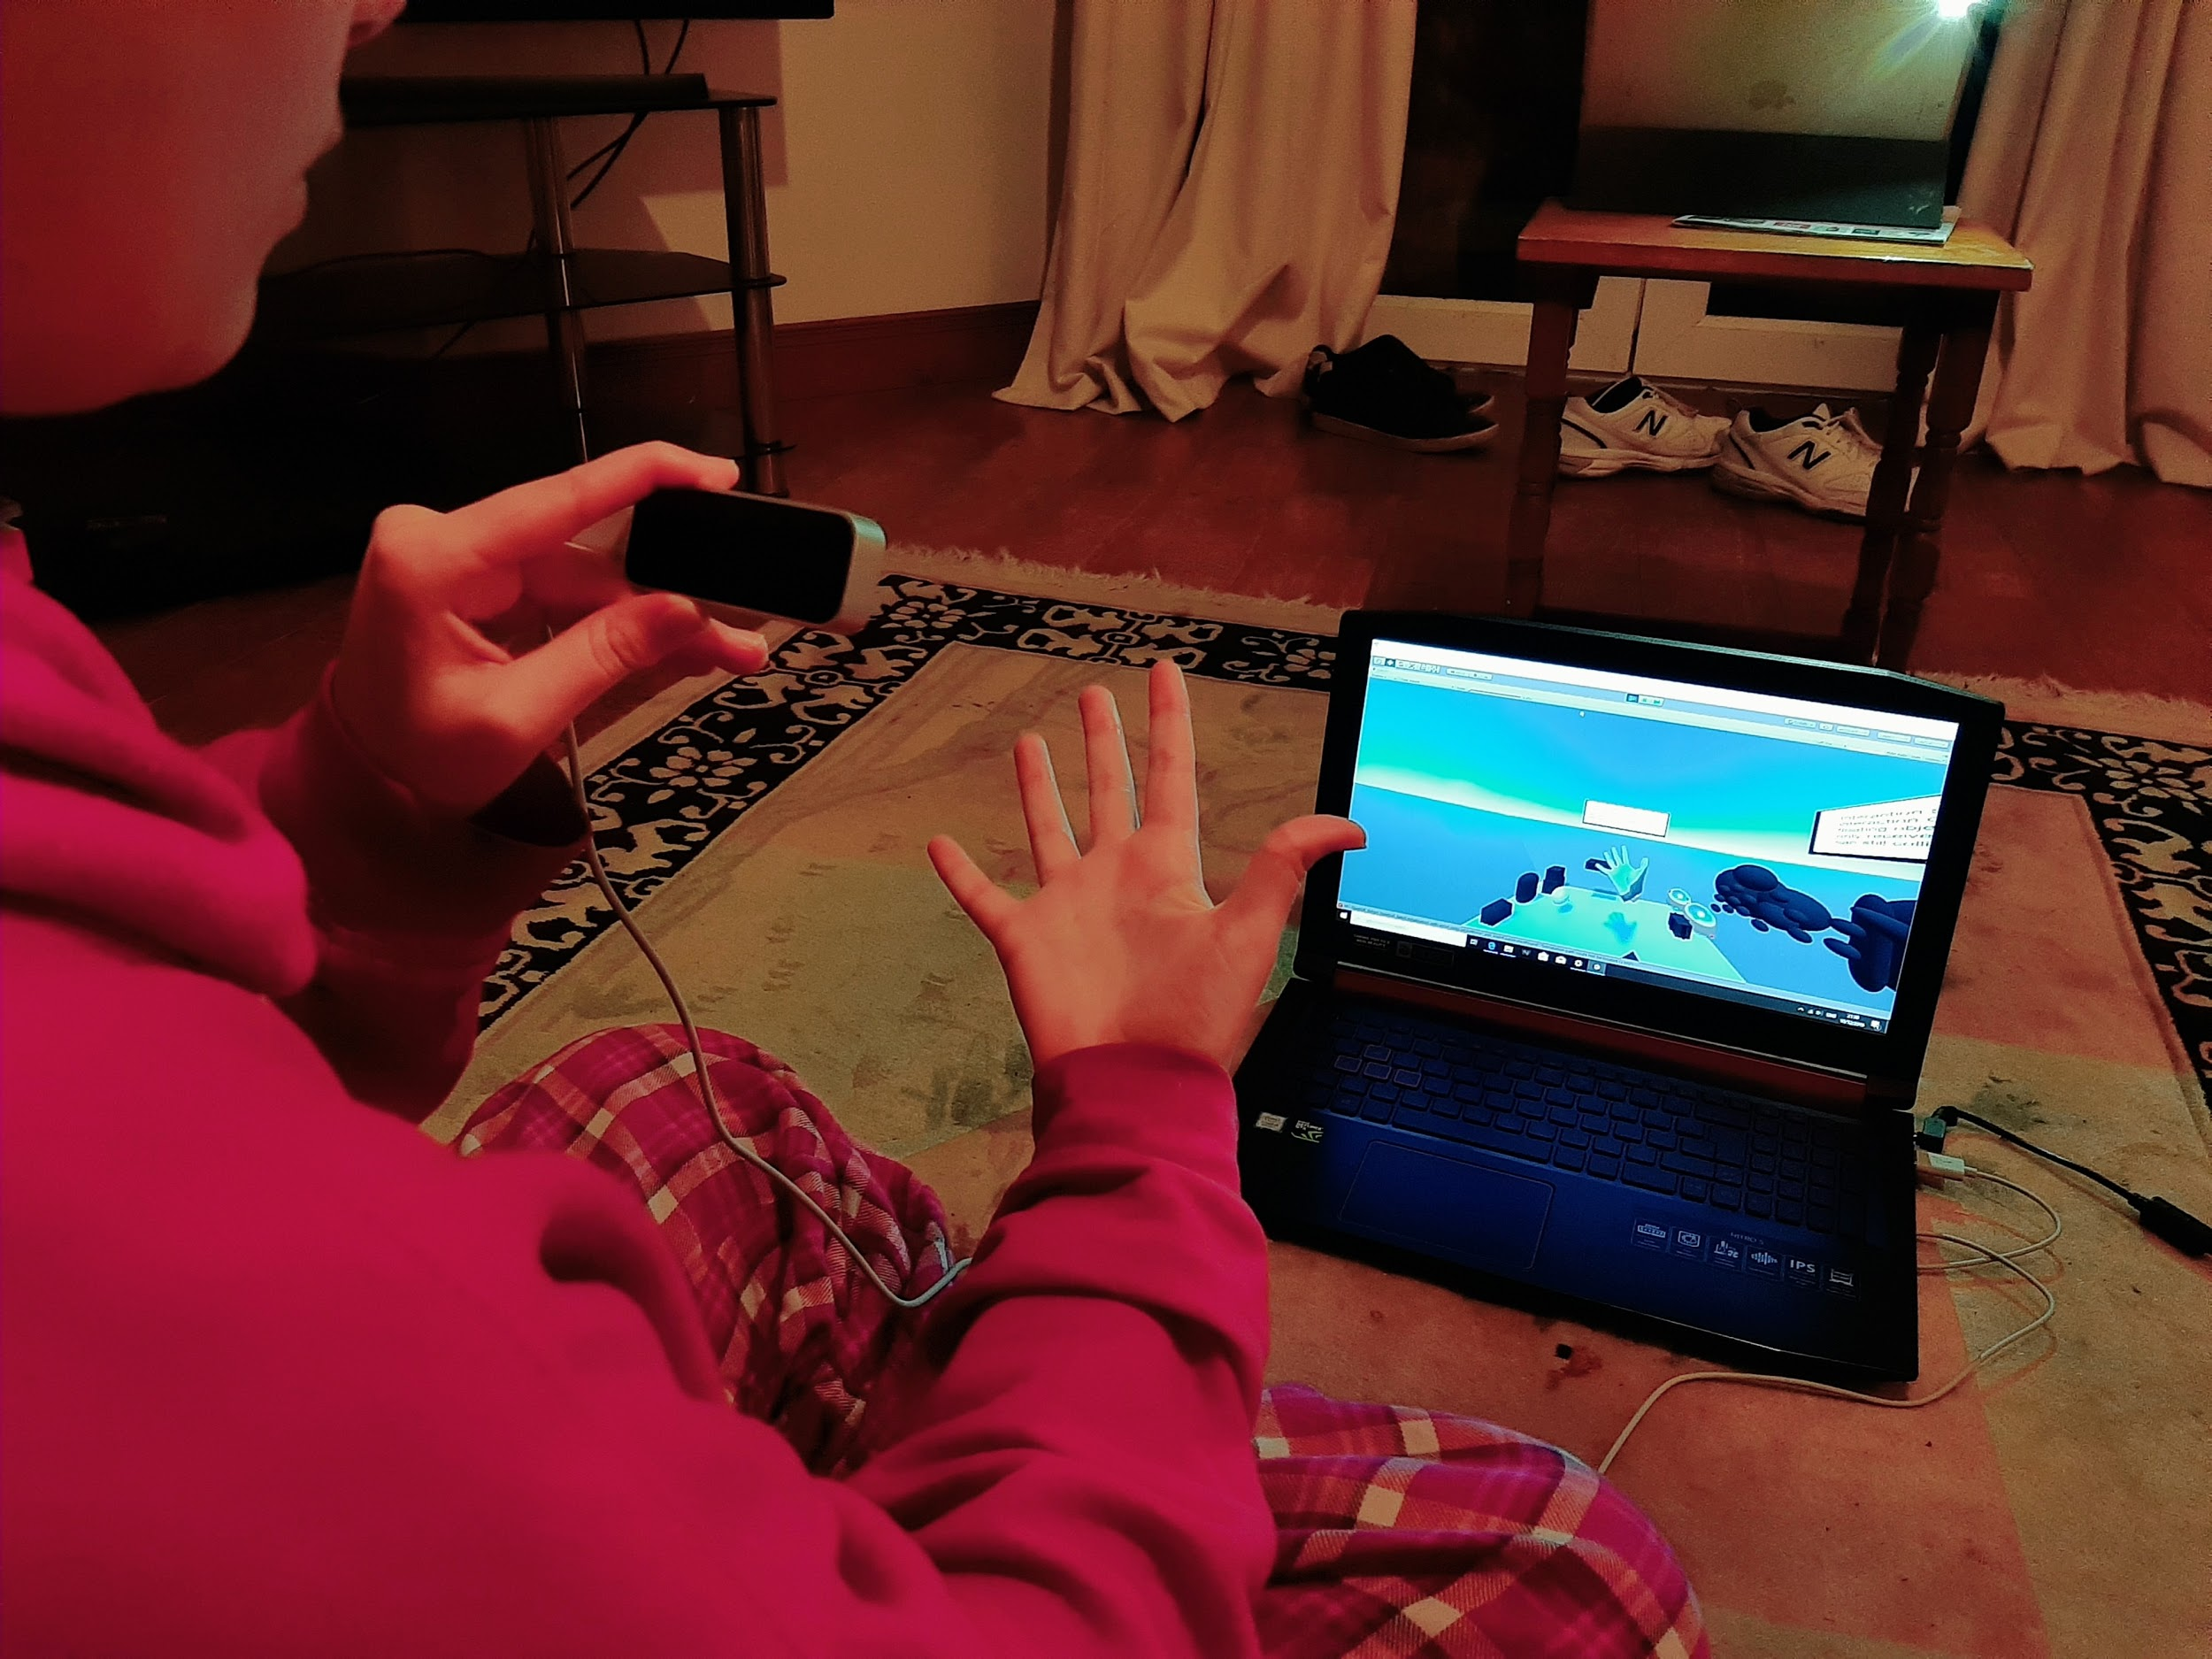
Introduction
The task that I chose to undertake and investigate for my Final Year Project was to explore the Leap Motion Controller.
During the investigation, I sought to answer the question ‘Can a Leap Motion Controller be used as a substitute for a Game Console Controller or a mainstream Computer Keyboard?’.
A Leap Motion Controller is a Virtual Reality (VR) device that can be used alongside a VR headset or independently to create an interactive and immersive gaming experience.

Slide 3
Research
Commencing the research, the initial approach involved me familiarising myself with the Leap Motion Controller device itself. I had previously had very little knowledge of or experience with the device or VR devices in general.
Right from the outset, I recognised some limitations and disadvantages with the device, eg. its connectivity and at times the apparent temperamental setup process. However, the way it encourages more interaction in game play, which is being increasingly utilised in today’s gaming world with VR and AR games like Pokemon Go, I believe outweighed the disadvantages. But most importantly it was easy and fun to use.

Slide 4
Research (Continued)
Following on from my initial findings, I constructed a functional labyrinth style game where the Leap Motion Controller was to be the key element in regulating the movement of a hedgehog through a box maze. The final objective was to transport the hedgehog to its burrow.
To demonstrate the communication of the Leap Motion Controller with the maze board in comparison with other more mainstream devices, I had to ensure the game also could be used with the arrows on a computer keyboard.

Slide 5
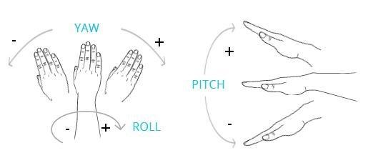
Project
I chose to generate a hedgehog themed labyrinth game that can transition smoothly between the game screens and levels.
For each level, I made a maze platform that could be rotated through either the Leap Motion Controller or the keyboard. There was also a Refresh Button available in the event that you made a error and wanted to restart the level, as well as a Home Button to bring the user back to the Main Menu if you wished to quit the game. I included a timer to each level in order to motivate the player to try to complete the levels as quickly as possible.

Slide 6
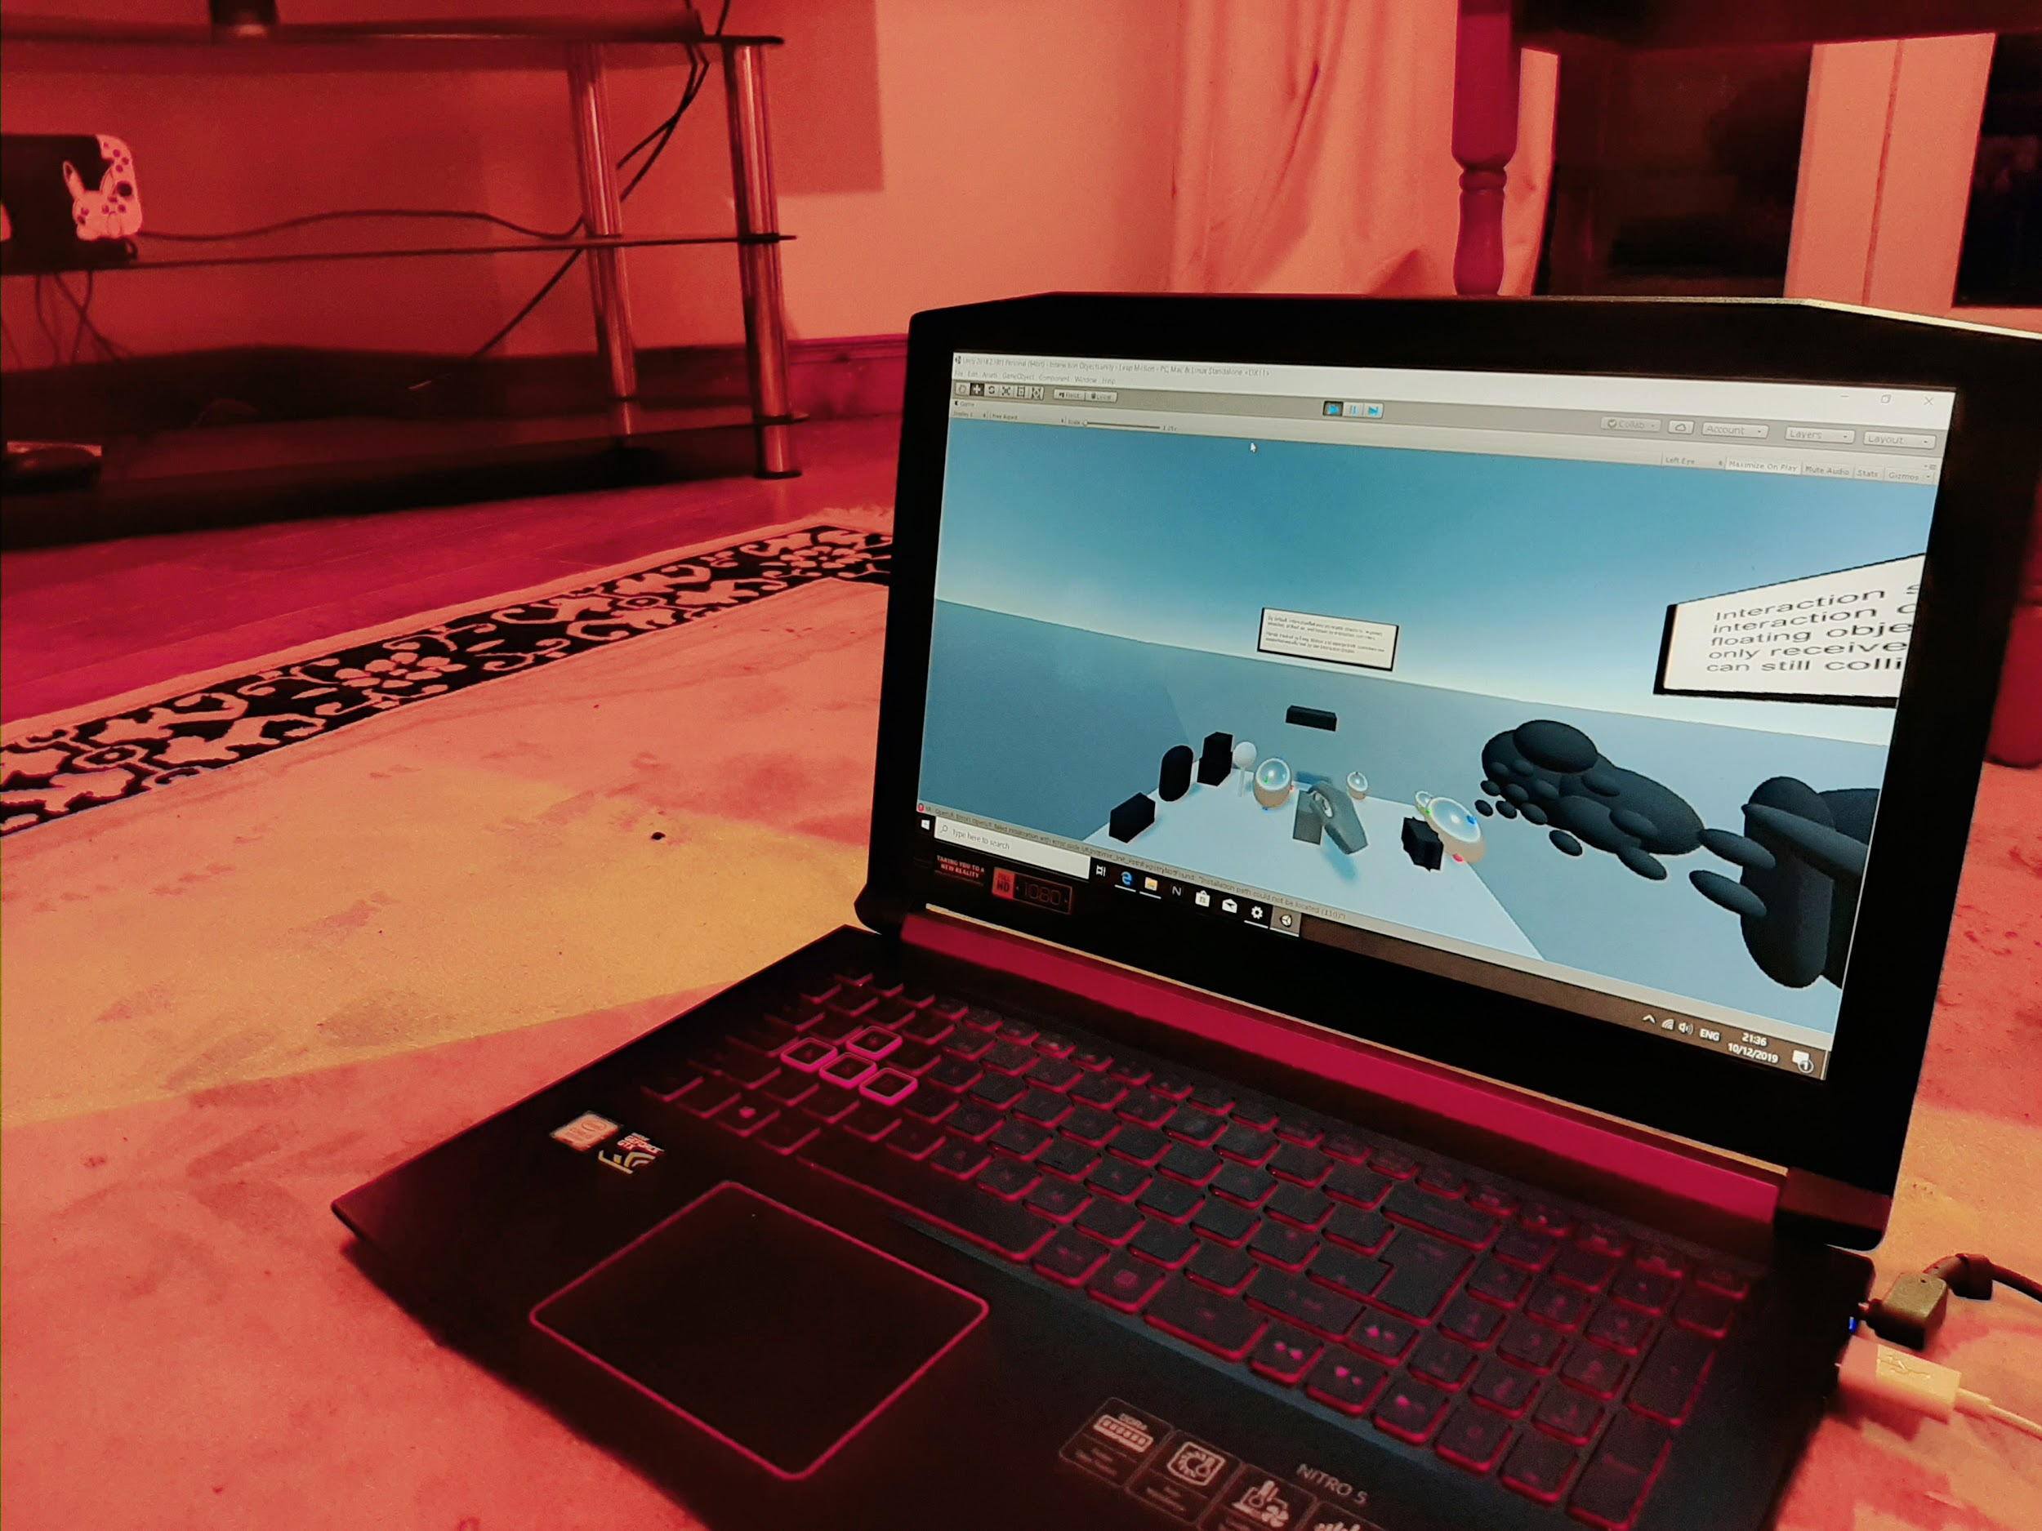
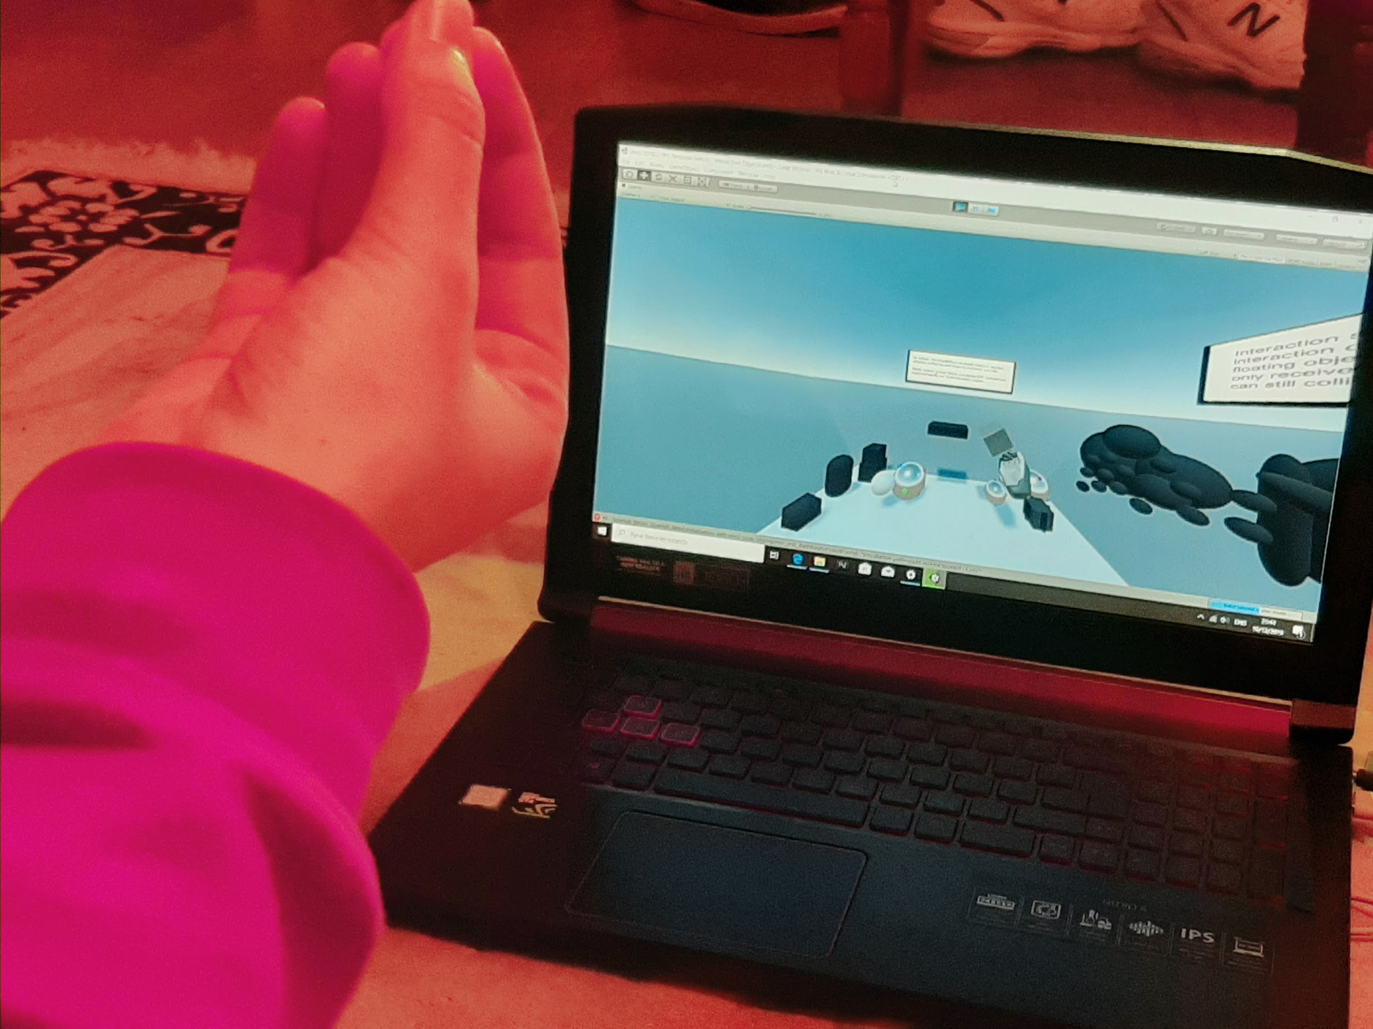
Results
As a result of my continued research, I have found that it was very difficult to program the functionality for the Leap Controller rotations as accurately as I had hoped. In addition, I encountered a few glitches, such as Controller connection, and rotation going over set limits.
Due to these mishaps, I came to the conclusion that the Leap Motion Controller may not be a complete substitute for a game console controller. However, I feel that with a more precise setup, this device may be an effective tool to be used for specific kinds of game similar to the maze game I have created.

Slide 7
Video Demonstration:
Video

Slide 8
Questions?
Thank You

